Slide 1
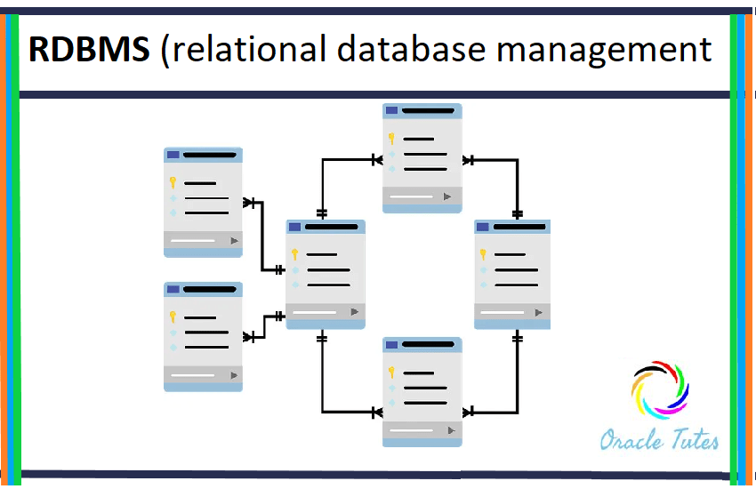
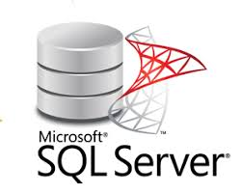
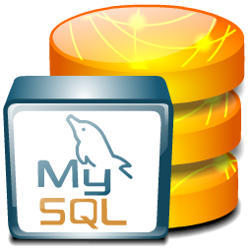

Introduction: A Relational Database Management System (RDBMS) is a collection of programs and capabilities that enable IT teams and others to create, update, administer and otherwise interact with a relational database.

Slide 2

MY SQL:
MySQL is an open source relational database server. A database server stores data in separate tables rather than putting everything together in a single table.
SQL in "MySQL" stands for "Structured Query Language": the standard language for database processing.
In everyday use, an application will usually only have a database. In MySQL (and also in other relational database applications), a Database is a collection of interconnected tables. A database is a place where tables will be created.

Slide 3

PostgreSQL:
PostgreSQL is a relational and object database management system (RDBMS). It is a free tool available under the terms of a BSD-type license.
PostgreSQL has many great features. Among these, we can mention by example: •
• transactional engine
• compliance with SQL standards•
MVCC (mechanism allowing effective competition without locking inrecords to ensure transaction isolation)
• stored procedures in many languages
• triggers
• continuous master-slave replication by application of binary logs (WAL archives),slaves accessible in read mode.

Slide 4
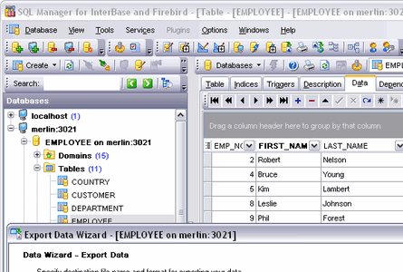
SQL SERVER:
SQL server commonly refers to a database server. The definition of SQL server is closely linked to that of SQL (Structured Query Language), a computer language used to exploit databases.
Concretely, a SQL server is a tool which has all the characteristics to be able to support the user in the manipulation, the control, the sorting, the update, and many other actions still, of databases thanks to the SQL language.
There are many different versions of Microsoft SQL Server, catering for different workloads and demands. A data centre version is tailored to higher levels of application support and scalability, while the Express version is a scaled down, free edition of the software.

Slide 5
Comparison between the three RDBMS
(MySQL, PostGreMySQL and MySQL Server)
My SQL | PostgreMYSQL | MySQL Server
MySQL is an open-source product., | PostgreSQL is an open source project. | commercial
C and C++ | C | C++
SELECT col1, col2 | SELECT col1, col2 | SELECT col1, col2
Oracle | PostgreSQL Global Development Group | Microsoft
Immediate Consistency | Immediate Consistency | Immediate Consistency
Widely used open source RDBMS | Widely used open source RDBMS | Microsofts flagship relational DBMS
Organizes index into clusters and tables (not very flexible search) | Flexible search | Rich automated functionality for index management

